Slide 1
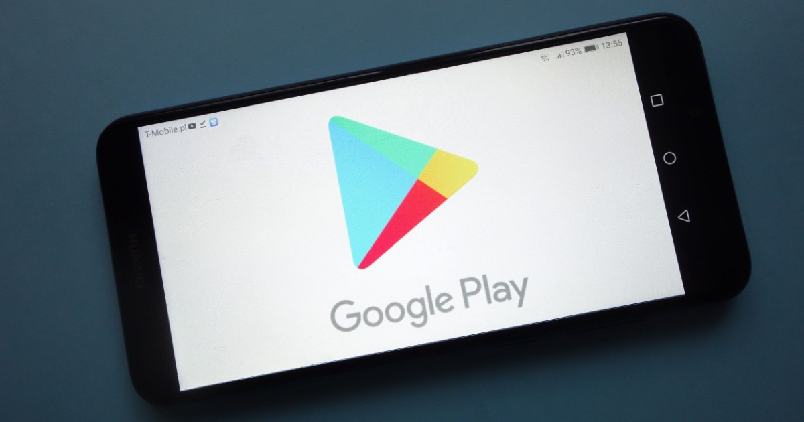
S.MADHAN KUMAR

Slide 2
DATA ANALYTICS PROJECT ON GOOGLE PLAYSTORE
OBJECTIVE :
The Project I have chosen on Data analytics in Google playstore.
This will Predict the score of the google play store apps with some Machine learning algorithms.
The Prediction is done by getting Inputs like Rating,Reviews,Size,Price,Android Ver.
It is hard to do projects in a domain you do not know or understand. You should understand the situation of the data and the importance of it. Suppose you want to build a model to predict. You should know the domain to understand the variables to gather, to use the data to predict the outcome. If you understand the domain you will understand false positives, outliers, and better measure errors. If you do not have a domain about google playstore. you will not be able to make a model. After you get the data and model, you should understand and analyze the data so you can communicate your findings. These are just a few important reasons why domain knowledge is important.
DOMAIN KNOWLEDGE :

Slide 3
BACKGROUND
Imported necessary Libraries for the Program and get the necessary data.
dropped unwanted columns from the Dataset.
Converting Categorical features using Encoding method and converting Date string into Date object.
Then Done Train and Test Split and 3 Machine learning Algorithms
Algorithms
There are many algorithms we can use on our dataset. Some algorithms will work better for you over others. You will just have to try few different algorithms for your dataset, and see which one gives you the best results. Here are few popular algorithms we used that worked best for our dataset.

Slide 4
WHAT YOU DID ?
I have used unsupervised and supervised methods.
Unsupervised Methods :
Unsupervised learning is a type of machine learning that does not require labelled data to train a model.
Unsupervised Learning also is a way to do machine learning that helps with clustering analysis. Clustering analysis helps find hidden patterns in data using similarity.
Supervised Methods :
Supervised learning takes a known input set in a dataset and tries to learn the regression or classification model.
The Algorithms are Longistic Regression, KNN,DecisionTree Classifier and RandomForest Classifier.
Taken the Best Suited Algorithm and Finally Done the Deployment for the Project .

Slide 5
CONCLUSION
The Play Store apps data has enormous potential to drive app-making businesses to success. Actionable insights can be drawn for developers to work on and capture the Android market! This shows that given the Size, Type, Price, Content Rating, and Genre of an app, we can predict about 57% accuracy if an app will have more than 100,000 installs and be a hit on the Google Play Store.
From 4 Machine learning Algorithms KNN algorithm shows less errors when compared to other 3 algorithms.
In Order to Give The Prediction in More Accurate Form Since it shows less Errors.

Slide 6


